Slide 1
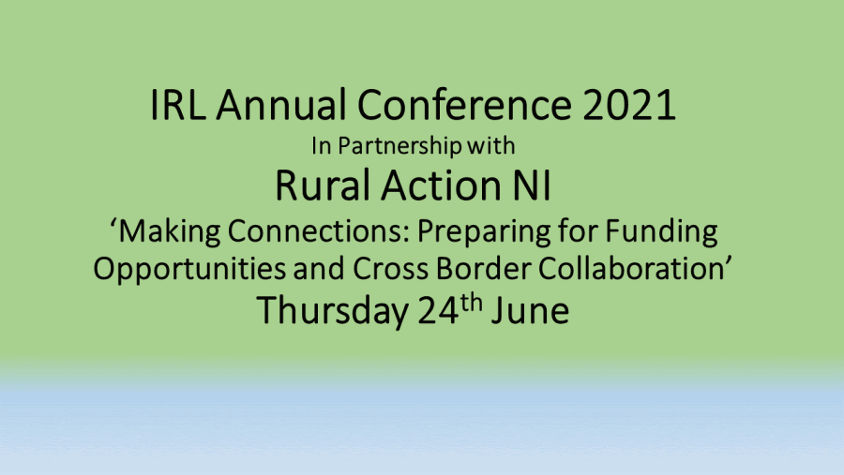

Slide 2
Social Enterprise Development Derek Browne
How social enterprise is a key contributor to rural development and social inclusion and the opportunities for greater collaboration in developing social enterprise in communities.
What is Social Enterprise?
What is the ABC Social Enterprise Programme?
Case Study: Rathfriland

Slide 3
Introduction
Derek Browne
Accountant and business adviser
Specialise in social enterprise
Deliver the Social Enterprise Programme for Armagh City, Banbridge & Craigavon Borough Council – mentoring, business planning, networking, advice & training
ABC Council is a mix of urban and rural communities with a population of approx. 200k
Strategic development - Town Centre Regeneration Task Force, Community Planning Working Group
Programme focus on enterprise, linking community/social causes and enterprise, reconnecting communities with town/village centres

Slide 4
What is Social Enterprise?
A social enterprise is “a business with primarily social objectives, whose surpluses are principally reinvested for that purpose, rather than being driven by the need to maximise profits for shareholders.”
A business focused on doing good as well as making money (not not-for-profit)
Social enterprises should charge for what they do, and social entrepreneurs should be paid for what they do
SEs should aim to make a profit and be sustainable without depending on external funding
SEs can be in any business sector
SEs should compete on the basis of price, quality and customer service
The key difference is how profits are used

Slide 5
Benefits of Social Enterprise
Peter Holbrook, chief executive of Social Enterprise UK, “the rise of social enterprise businesses could help fix many of society’s ills. These are businesses that are outperforming traditional SMEs on turnover and innovation, and they are leading the way when it comes to diversity and fair pay, as well as creating jobs and opportunities in the communities where they are needed most.”
Demand from the market is fuelling a boom. UnLtd found 73% of consumers are more likely to buy from brands that put purpose before profit. Among those under 35, it’s 81%.

Slide 6
ABC Council Social Enterprise Programme
SE Strategy sets out a framework for the development of social enterprise in the borough
Set in context of the Programme for Government, Connected - the ABC Community Plan and other strategic initiatives
Placing social enterprise as an important part of economic and community development plans in the borough
Sets targets for start ups and job creation
Programme provides mentoring, business support, business planning, networking and collaboration, advice, training and signposting

Slide 7
Case Study: Rathfriland & District Regeneration Co
Rathfriland is a large village, Co. Down – Pop. 2,700 – ABC Council
Rural area
Gateway to the Mournes
Rich history and heritage
Village square – Market House
Declining village commercial centre – several empty buildings
Lots of community activity – lots of community space
RDRC is a community owned regeneration co.

Slide 8
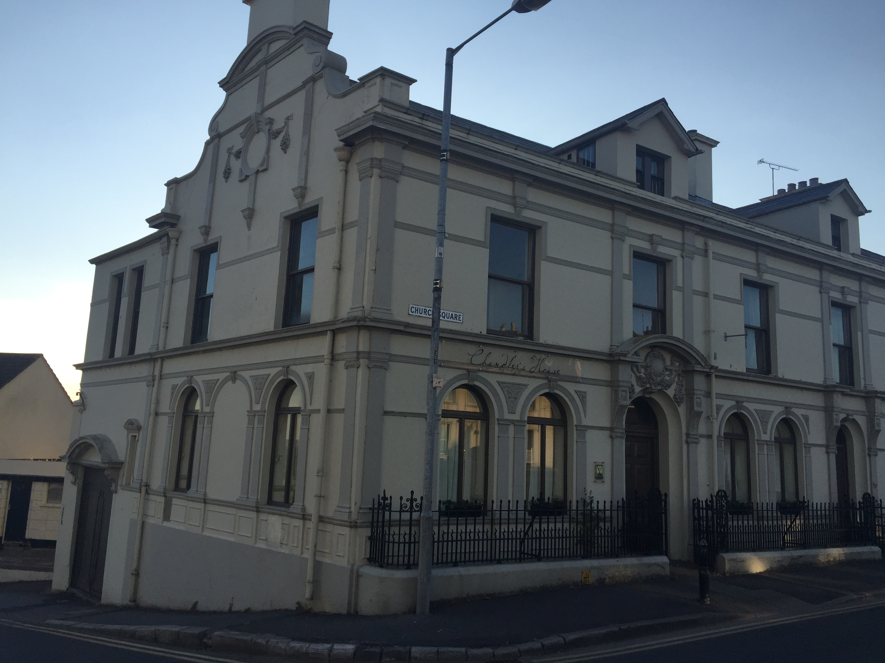
Chandlers House
Former bank premises – empty since 2017
Acquired by RDRC in 2014
3 storeys – deteriorating condition
Built in 1800’s - part of a vibrant village square
Plans for community use - no evidence of need
Needs and opportunities – music/ arts venue, heritage, residential
AHF support, Village Catalyst
Planning approval in place – music/arts venue ground floor, 4 apartments upper floors
Finalising finance package mix of funding, loan and community investment - £600k project
Plans to start work within 2 months

Slide 9
Outcomes of social enterprise model
Community involvement, activity and participation
Taking a broad view of opportunity
Challenging the normal, open to new ideas and new thinking
Creating a facility for everyone
Sense of place and shared history
Bringing life to the village centre
Residential use
Generating profit for good
Catalyst for other businesses
Community focused – involvement, participation, connection
What is best for the area – what is needed, who can benefit?
Social purpose – people investing in their own community
Profits reinvested & sustainablility
Connecting community with the village centre - a sense of “our place for everyone”

