Slide 1
Next Generation Business – A Vision for Small Firms in Ireland
Irish Rural Link Annual Conference
“Micro Enterprise: A Key to Rural Employment
– Outlining Pathways to Europe”
Date: Author:
5/5/2017
Patricia Callan
Twitter: @SFA_IRL

Slide 2
SFA Vision SFA Mission
Ireland – the most vibrant small business community in the world – supporting entrepreneurship, valuing small business and rewarding risk takers.
The Small Firms Association is the trusted partner of small businesses in Ireland. Its mission is to deliver business-focused advice and insights to member companies, influence government policy to the benefit of small businesses and connect its members in a thriving community.
Irish Rural Link Annual Conference
5/5/17

Slide 3
Small Business in Ireland
Irish Rural Link Annual Conference
5/5/17

Slide 5
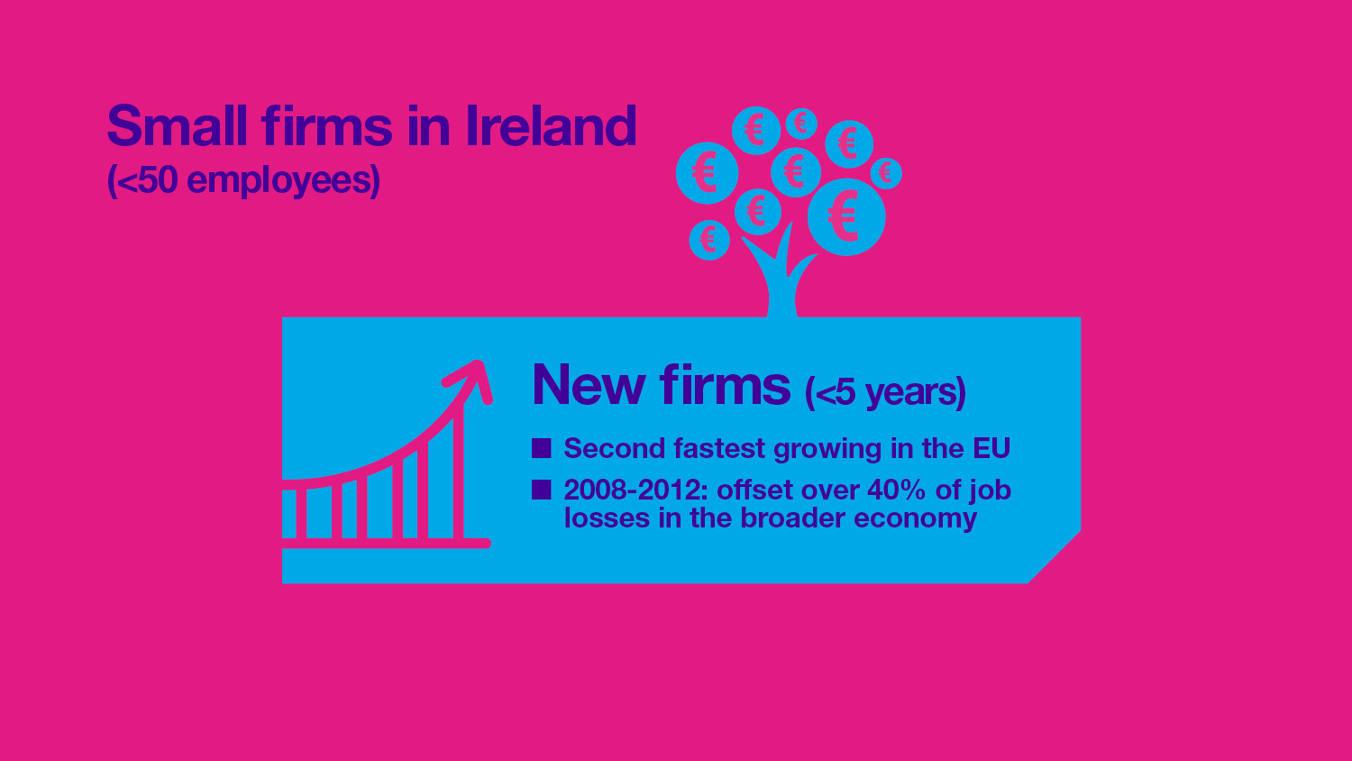

Slide 9
Economic Outlook and SFA Member Sentiment
Irish Rural Link Annual Conference
5/5/17

Slide 10
Economic Outlook
Brexit / Trump / European Elections / Anti-free trade sentiment: Momentum, but slowdown
Domestic demand has had strong areas of recovery but remains well below peak levels. Retail turnover for example is 12.5% below its 2007 peak.
The regions are also still lagging behind Dublin in terms of recovery to peak levels of activity
Sectors such as agri-food, retail, manufacturing and tourism are facing into more difficult climate as the full implications of Brexit bite.
Irish Rural Link Annual Conference
5/5/17

Slide 11
How would you characterise the current business environment?
May 2016
November 2016
Irish Rural Link Annual Conference
5/5/17

Slide 12
The Opportunities
Domestic Economic Growth
New brand or marketing campaign
New products
Specific Sectoral Opportunities
Exporting
Acquisitions
Trading Online
Government/EU Funding or Contracts
Irish Rural Link Annual Conference
5/5/17

Slide 13
The Risks
Wage Inflation
Domestic Economic Stagnation
Brexit/Sterling Exchange Rate
Difficulties in Attracting Talent
Legislative/Regulatory Burden
Instability of the Minority Government
Other Business Costs
Cashflow
Debt
Irish Rural Link Annual Conference
5/5/17

Slide 14
Brexit – Implications for Irish Small Firms
Irish Rural Link Annual Conference
5/5/17

Slide 15
The Big Challenges
Irish Rural Link Annual Conference
5/5/17

Slide 16
IMPACT OF BREXIT ON YOUR BUSINESS | TO DATE (NOV 2016) | NEXT 6 MONTHS
Very negative | 12% | 11%
Somewhat negative | 29% | 57%
No impact/neutral | 50% | 22%
Somewhat positive | 9% | 8%
Very positive | 1% | 2%
Irish Rural Link Annual Conference
5/5/17

Slide 17
SPECIFIC IMPACTS OF BREXIT ON YOUR BUSINESS | TO DATE (NOV 2016) | LIKELY IN THE FUTURE
Loss of business in UK market | 37% | 45%
Loss of business in Irish market | 30% | 45%
Loss of business in third country market(s) | 2% | 4%
Workers put on short time/layoff | 0% | 7%
Workers made redundant | 2% | 1%
Postponement of investment decisions | 52% | 37%
Increased sourcing of raw materials in UK market | 20% | 18%
Movement of production/operations to UK | 3% | 4%
Irish Rural Link Annual Conference
5/5/17

Slide 18
SFA Lobbying
Bilateral meetings with Minister for Jobs, Enterprise & Innovation, Mary Mitchell-O’Connor, TD
Bilateral meetings / Workshops with Brexit Response Unit – DJEI, D/Finance, EI, SBCI
Oireachtas Symposium on Brexit
All-Island Civic Dialogue / Sectoral Dialogues
Joint Oireachtas Committee on Jobs, Enterprise & Innovation / Seanad Select Committee
Standing agenda item on all government committees
Public Meetings
UK Government / EU Commission
Media
Irish Rural Link Annual Conference
5/5/17

Slide 19
Key Asks - Immediate
Lobby EU for temporary state aid rule changes – Enterprise Stabilisation Fund / Job Support Measures
Financial Supports – SBCI low-cost finance / export financing
State Agencies – market diversification and innovation
Public Awareness Campaign – “support Irish food producers and retailers”
Extend On-line Trading Voucher Scheme
Irish Rural Link Annual Conference
5/5/17

Slide 20
Key Asks – Short to Medium term
National Strategic Plan to deal with Brexit – risks and opportunities
Self-audit tool for all businesses
Exit negotiations – Ireland’s special position; UK to remain as close to European single market as possible
Preserve common travel area and open border
Cost-competitiveness
Tax Competitiveness
Irish Rural Link Annual Conference
5/5/17

Slide 21
Brexit Toolkit – 10 Areas to Assess Sector-Specific Analysis Contain, Assess, Position, Take Action
Currency
Supply Chain
Contracts
Finance and Funding
Workforce
Technology
Regulation
Tax
Market
Operating Structures
Irish Rural Link Annual Conference
5/5/17

Slide 22
Questions?
Irish Rural Link Annual Conference
5/5/17

Slide 23
Further Information: Patricia Callan, SFA Director 01 6051602 / 087 6999345; patricia.callan@sfa.ie www.sfa.ie / www.sfa.ie/awards ; Twitter: @SFA_IRL

