Slide 1
Microenterprise
Irish Rural Link conference

Slide 2
Where are the jobs?
EU study on where the jobs come from
85% of net new jobs in the EU between 2002 and 2010 were created by small and medium sized enterprises (SMEs). This figure is considerably higher than the 67%-share of SMEs in total employment
Secondly new firms (younger than five years) are responsible for an overwhelming majority of the new jobs. New enterprises operating in business services create more than a quarter (27%) of the new jobs, while the new firms in transport and communication contribute least (6%).
USA Kauffman study
the majority of new jobs created in the U.S. aren't created by companies like Intel, but by start-ups. The Kauffman Foundation's analysis of Census Bureau statistics shows that net job growth in the U.S. economy occurs only through startup firms. From 1977 to 2005, existing companies were net job destroyers, losing 1 million net jobs per year. In contrast, new outfits in their first year added an average of 3 million jobs annually. http://www.kauffman.org/uploadedFiles/firm-formation-neutralism.pdf http://www.businessweek.com/technology/content/jul2010/tc2010079_953836.htm

Slide 3
How We Work With Start-ups…
Identifying
HPSU Start
HPSU Accelerate
Over 2,000 enquiries
Milestone Setting Meeting
Progress Update
Overseas Support
Sprint
Business Plan Update Meetings
Master Class Series
Founders Forum
Forum Groups
Overseas Support
900 Business Plans
Exit 100
HPSU
Accept 450
0-18 Months
Fast Track
Engage HPSU Accelerate DA & IC
24 Months
Fast Track
Notes:
Start up client journey within HPSU

Slide 4
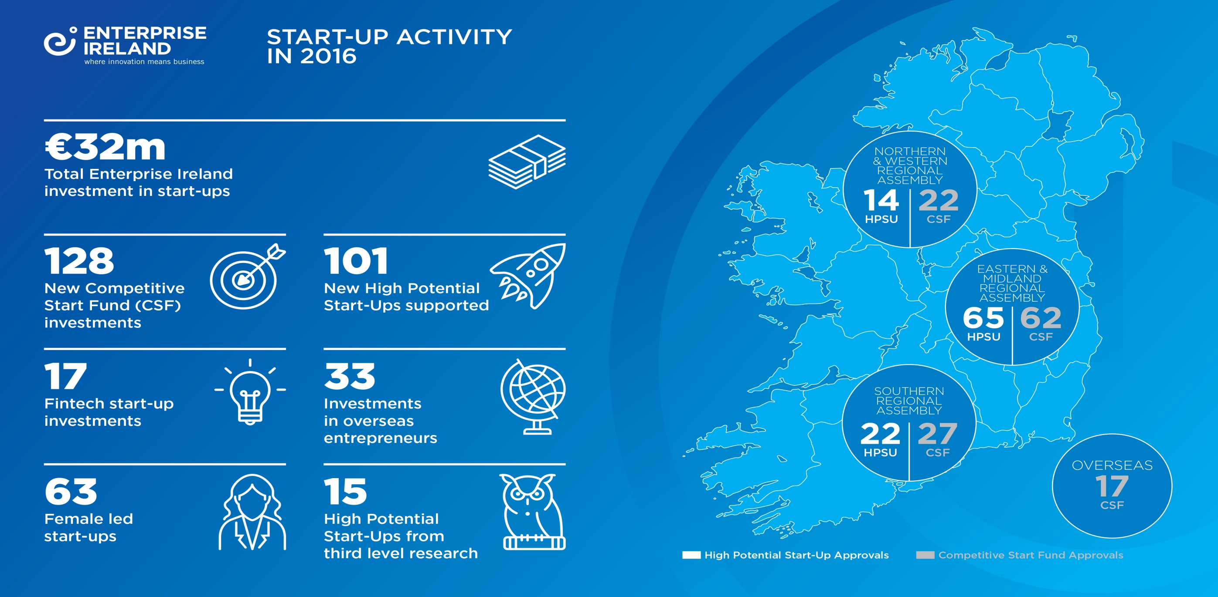
Start-up Activity 2016…

Slide 5
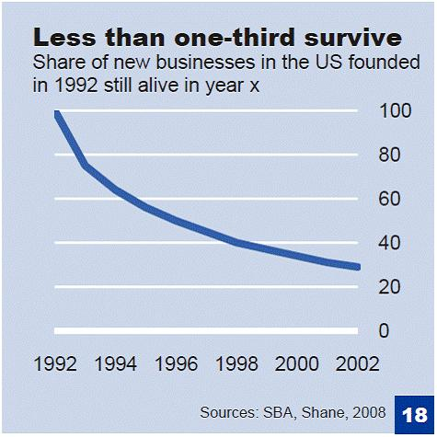
US high-tech entrepreneurship: The "get rich or die trying spirit" that brings results
the US economy excels in the creativity, audacity and pragmatism that is needed to seize the opportunities that arise from global research and to turn them into successful ventures
Founding a new firm is an inherently risky venture
Typically, less than 30% of the start up’s in the United States survive to see their 10th anniversary, with the first years being the most dangerous ones.
Started with those founded in 1992 and tracked them for 10 years

Slide 6
Why do most startups Fail
Traditional product development model has two implicit assumptions
That the customer problem/need is known
That the product features are known
Most Business plans don’t survive first contact with customers
Most start-ups fail from a lack of customers than from a failure of technology
Concept
Product Dev.
Alpha/Beta Test
Launch/
1st Ship

Slide 7
What is a start-up?
Not just a smaller version of a large company.
startup is a temporary organization designed to search for a repeatable and scalable business model.
a startup can be a new venture or it can be a new division or business unit in an existing company.
Notes:
In existing companies think R&D project……90% failure rates

Slide 8
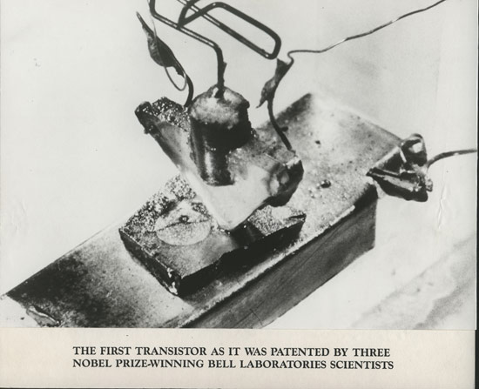
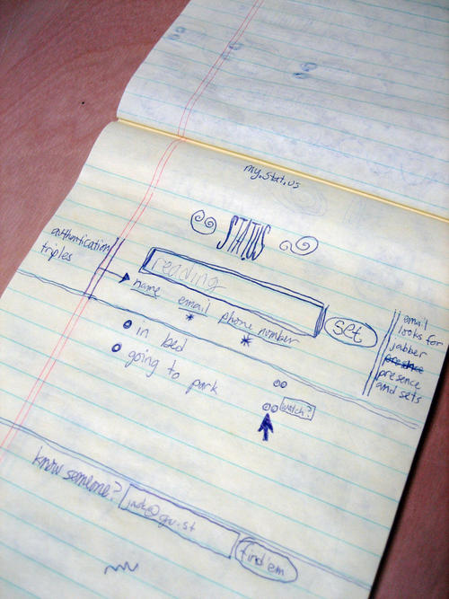
If brilliant and stupid ideas look the same at the early stage then how can u decide which to follow
Notes:
It's not much to look at--the overriding impression is of several mangled paper clips clumsily soldered onto some chunky scrap metal--but really, the whole of modern digital life stems from it.
This was the very first transistor, invented at Bell Labs in December 1947. Known as a point contact transistor, it was first manufactured commercially a few years later, ironically enough, in a textbook example of a Rust Belt locale: Allentown, Pa.
From this first transistor arose, eventually, Intel and Advanced Micro Devices, Silicon Valley and Massachusetts' Route 128 corridor, countless brands of desktop and laptop PCs, the PlayStation 3 and the iPhone...

Slide 9
Focus on the Business Model and the customer development process not just the idea

Slide 10
Why now for start-ups
Information and knowledge is everywhere
http://techcrunch.com/
https://www.startupschool.org/
http://www.crunchbase.com/
http://steveblank.com/tools-and-blogs-for-entrepreneurs/
https://www.udacity.com/course/ep245
http://www.unleashingideas.org/global-entrepreneurship-library/
http://www.technologyreview.com/
http://marblar.com/technologies?src=dbinnNASA&goback=%2Eanb_164166_*2_*1_*1_*1_*1_*1#%21
Cost of doing a startup dropping all the time
Facebook needed their own servers….you don’t
The Mobile revolution
Snapchat, spotify
Mobile first vs mobile add on to desktop
Mobile born
Support for start – ups in Ireland very good
Accelerators
New frontiers
CFF, CSF, HPSU

Slide 11
Since early April, Y Combinator has been running a free, 10-week online course called Startup School: it’s meant to replicate a bit of the accelerator experience by combining online lectures from tech-world luminaries about starting a company with online mentoring from past Y Combinator participants and support from fellow Startup School students.

Slide 13
Startup school …..started April 2017
There was a lot more interest in the course than expected: in total, 13,500 startups applied to take part, and 3,000 were accepted.
There are about 30 startups per advisor.
Anyone can view the lecture videos on YouTube or on Startup School’s site https://www.startupschool.org —they are taped in front of an audience at Stanford University as they are also for a startup-building class Y Combinator is hosting there—and the four that have been uploaded so far have gotten over 80,000 views altogether.
Y combinator is the no 1 accelerator in the world

Slide 14
2040 ……. from the vantage point of today ….May 5th 2017
Most ( maybe all) of the products used in 2040 have not been invented (or conceived of) yet
internet only starting
People in the future will look at their holodecks, and wearable virtual reality contact lenses, and downloadable avatars, and AI interfaces, and say, oh, you didn’t really have the internet (or whatever they’ll call it) back then
Looking back from 2040 …..2017 from an entrepreneur’s point of view was an incredible, wide open frontier …easy to start, bmc and other great tools, most companies (eg retail) not engaged, impact of mobile on enterprise only clear to a few, IoT only starting (nest one of the few), cloud, …….
This is the time that people in the future will look back at and say, “Oh to have been alive and well back then!”
You are not late….. K Kelley https://medium.com/message/you-are-not-late-b3d76f963142
Lumiere bros…startling innovation….yet it took 30 yrs to catch on ….al jolson the jazz singer ….today movie industry is a $36B industry and its birth mother the theatre industry is a $2.6B industry globally
Democratization of Entrepreneurship

