Slide 1
Local Enterprise Office Westmeath
Irish Rural Link Conference
Micro Enterprise: A key to Rural Employment
– Outlining Pathways to Europe
5th May, 2017

Slide 2
Presentation by Christine Charlton

Slide 3
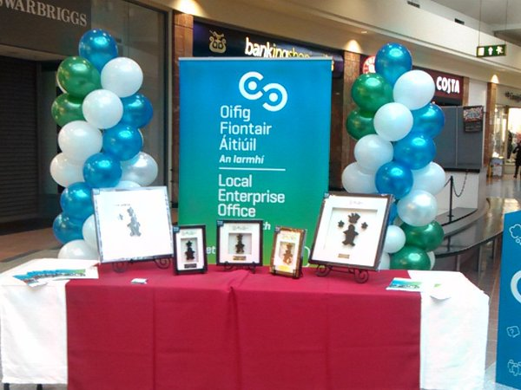
Agenda
LEO Services &
Supports
Exploring Export
Opportunities

Slide 4
Policy
Businesses with 10 or less employees
Start Ups
Existing

Slide 5
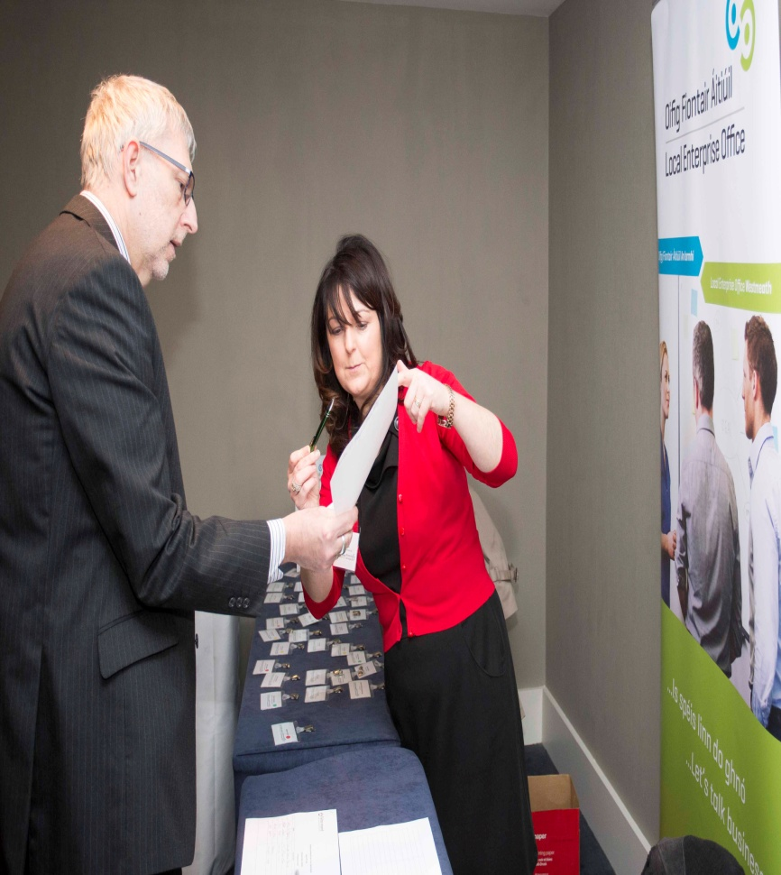
LEO Services and Supports
I. The provision of Business Information & Advisory Services
Business advice and information
Government business
Services
Accessing public procurement processes

Slide 6
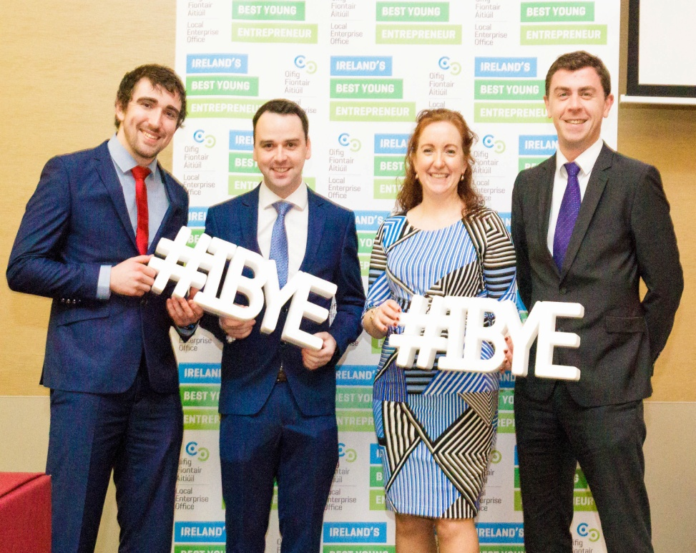
II. The promotion of Entrepreneurship Support Services
Student Enterprise Programme
Enterprise Awards
IBYE
NEA
Enterprise promotional activities

Slide 7
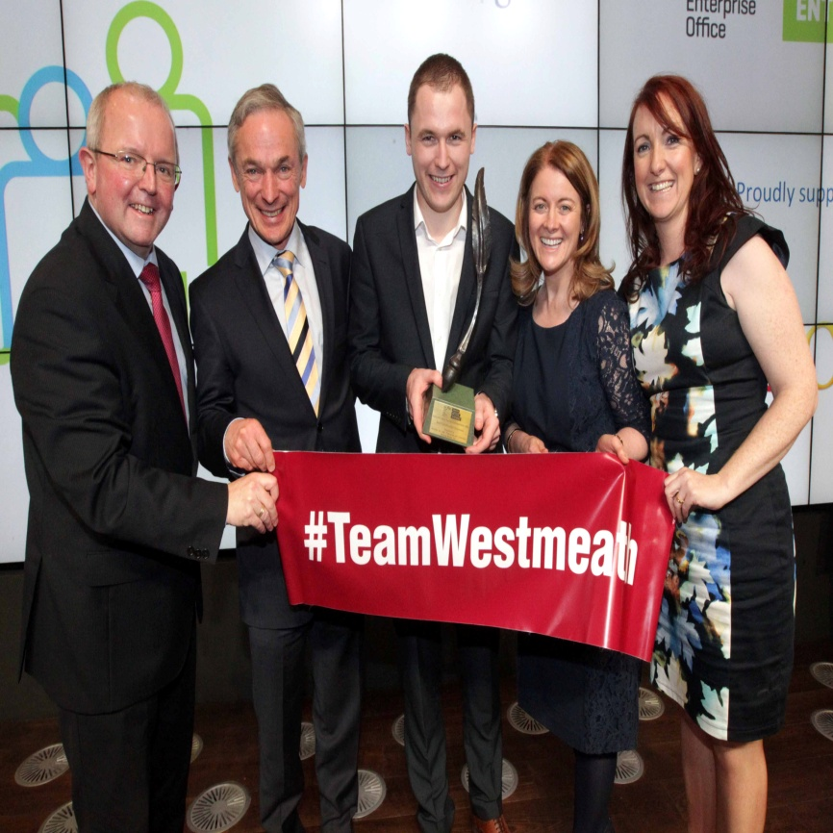
The promotion of Local Enterprise Development Services
Promotion & marketing of Westmeath
Business Incentive Scheme
Commercial Enterprise Space
Identifying & developing projects and
programmes
Leverage funding

Slide 8
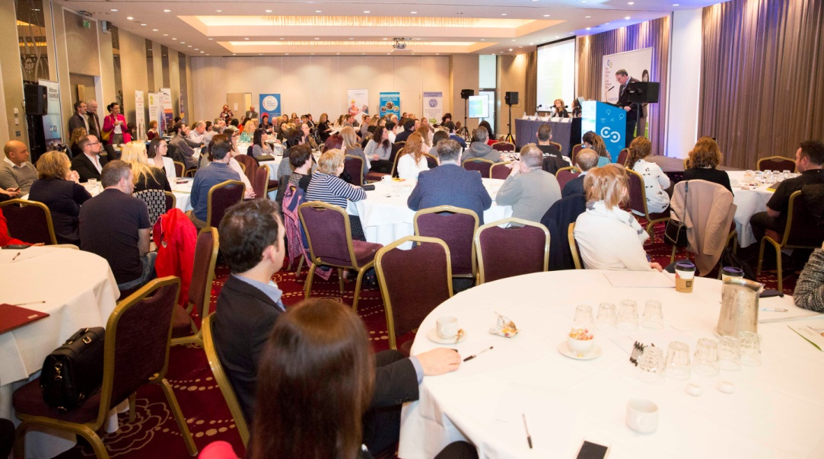
Iv. The promotion of Enterprise Support Services
Provide financial support for start-up and business development
Innovation
Start-up
Business Expansion
Business Training
Trading On Line Vouchers

Slide 9
IV. The promotion of Enterprise Support Services
Mentoring
Micro Finance

Slide 10
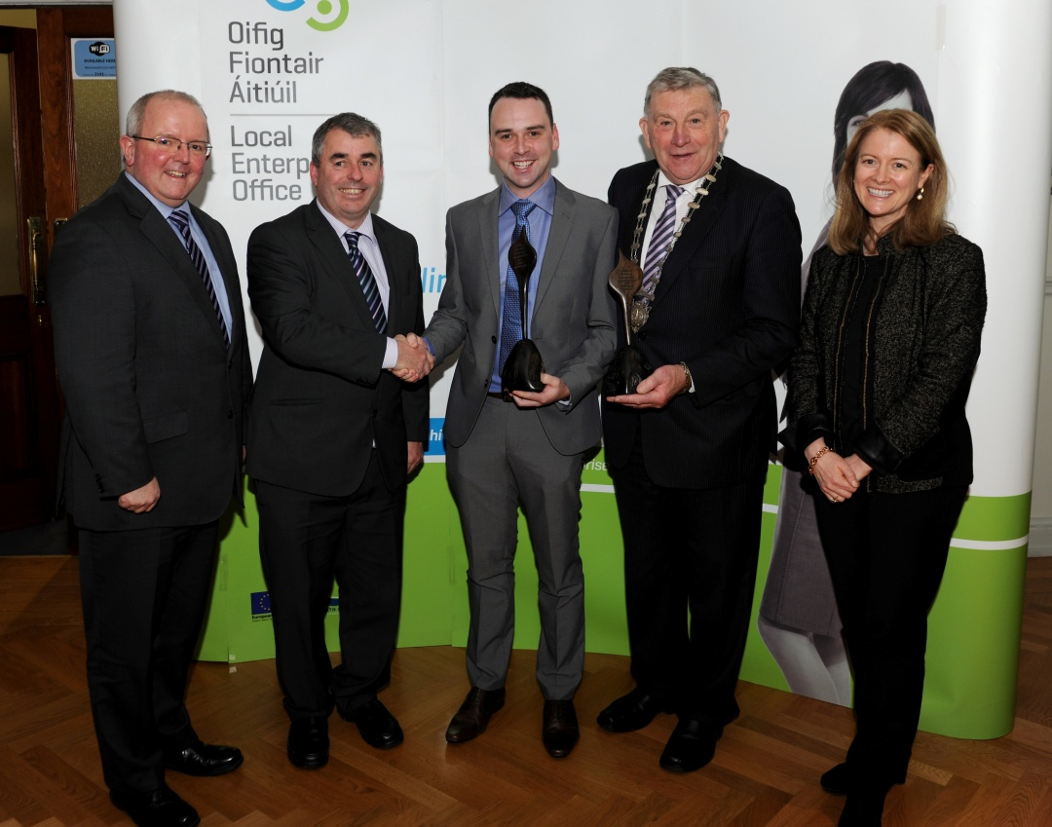
2. Exploring Export Opportunities – LEO Support
Advice
Mentoring
Website Clinics
Marketing Clinics
Seminars
Research
Enterprise Europe Network (EEN)

Slide 11
2. Exploring Export Opportunities – LEO Support
Grants
Micro Exporters Grant
Trading Online Vouchers (T.O.V)
Efficiencies
LEAN

Slide 12
1. LEO Services & Support
The provision of Business Information & Advisory Services
The promotion of Entrepreneurship Support Services
The promotion of Local Enterprise Development Services
The promotion of Enterprise Support Services

Slide 13
Thank You localenterprise.ie/westmeath

