Slide 1
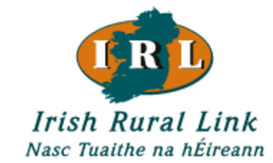
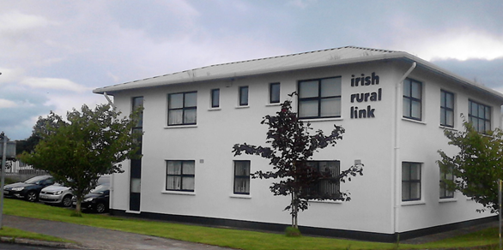
Irish Rural Link Founded 1991
General overview

Slide 2
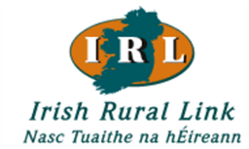
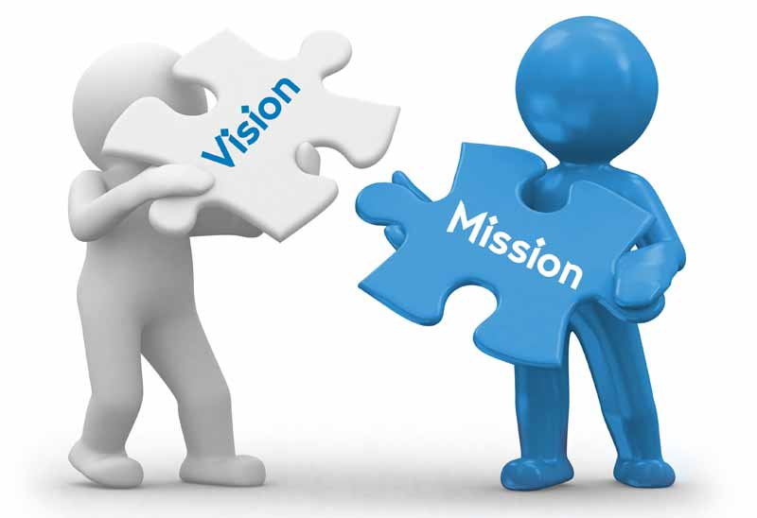
Our Vision and Mission Statement
“Our Vision”
is of vibrant, inclusive and sustainable rural communities that contribute to an equitable and just society’.
“Our Mission”
is to influence and inform local, regional, national and European development policies and programmes in favour of rural communities especially those who are marginalised as a result of poverty and social exclusion.’

Slide 3
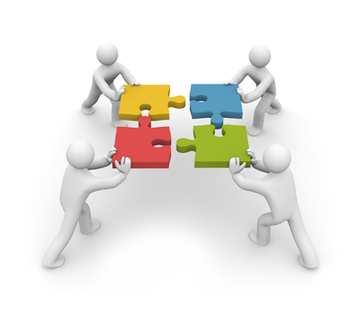
The Organisation
is a national network of organisations and individuals campaigning for sustainable rural development in Ireland and Europe.
represents the interests of community groups in disadvantaged and marginalised rural areas by highlighting problems, advocating appropriate policies and sharing experiences and examples of good practice through consultation
a non-profit organisation, has grown significantly since its inception and now directly represents over 1,200 community groups with a combined membership of 25,000.

Slide 4
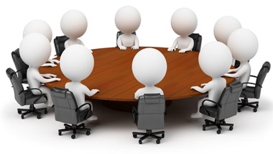
Our Board
The Executive Board of IRL are elected by its members.
It consists of 18 members plus co-opted members when deemed necessary.
We meet every 6 weeks (approx).

Slide 5
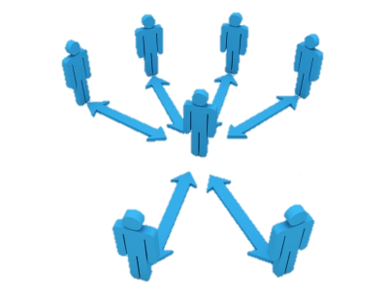
Members : Issue Based Networks
Currently IRL is encouraging its various members to form single issue networks within the umbrella of the IRL organisation.
The advantages are:
That we will support experts, who are knowledgeable about their area of interest.
It allows the interest groups to participate at the heart of policy making and in that context bring greater integrity to the problems and opportunities that may materialise.
The wider membership of IRL is also better informed, and because of that is more likely to take into account the issues that affect rural communities.
The agreed policy, because it is accepted by the wider rural family is more likely to be successful in terms of its influence.
This process is the preferred method for consultation to Government

Slide 6
Partners “The Community & Voluntary Pillar” Building Sustainable Rural Communities
The Community & Voluntary Pillar
Protecting the Vulnerable

Slide 7
About the Community and Voluntary Pillar (IRL current Secretariat)
The Community and Voluntary Pillar is nominated by government as the recognised advocate source with rights to participate in the social dialogue process.
Social dialogue gives IRL rights to represent rural issues direct to Government.
17 National members : Representing children, unemployed, disability, community and social justice, housing, older people and rural Development.
Inherent in such analysis is that IRL along with its colleagues are ‘critical’ of policies.

Slide 8
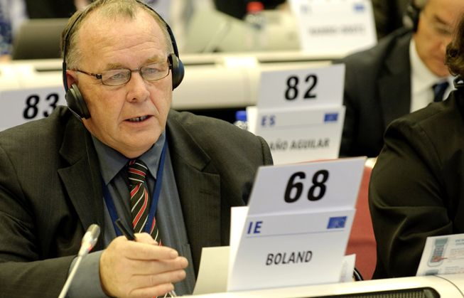
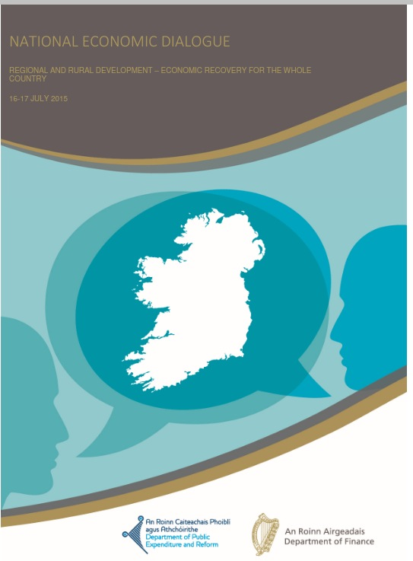
What we do at home & Europe
IRL writes submissions and articles on rural issues e.g. rural transport, services, infrastructure, income and so on.
IRL makes submissions to individual Government Departments or advise on specific issues
IRL has access to all of the political parties and elected members at local and national level.
Is represented at EU level.
Sits on various government committees, such as Peatlands Council, ESIOP, National Rural Water Services Committee, NESF, National transport Forum.
IRL CEO Seamus Boland at the EESC in Brussels and the National Economic Dialogue event Dublin
(Advocating Local Public Banks)

Slide 9
Thank You

